Slide 1
Using Lambdas in Java
Notes:
Hello, my name is Kuldeep. Welcome to the course of, Using Lambda Expressions in Java Code.

Slide 2
Prerequisites
Basic knowledge of Java
How to create and run a simple Java Program
Basic knowledge of Java Collection API
Java version 8+
Notes:
So, before we start here
What Should You Know to Follow this Course?
You need to have at least some basic knowledge about the Java language. You need to be able to write some basic Java code in your favourite IDE.
You need to have some basic knowledge on how a Java application is built.
In the examples, we're going to use the collection framework, so you need to have some basic knowledge about that.
And, of course, since this is a lambda expressions course, you need to have at least a Java 8 version installed for the course.
Lambda expressions have been introduced in Java 8, so this is a Java 8+ course. If you're using a Java prior to 7, then you cannot use lambda expressions. They have not been backport to the Java language prior to 7. If you're using Java 11 or past Java 11, this is also fine. You will be able to run all the examples we are going to see.

Slide 3
What will we learn today ?
How to work with lambda expressions
Writing lambdas
Invoking a lambda
Identifying what lambdas a method need into its parameters
Chaining and composing lambdas
Method References
Notes:
So, What's in it for you in this course? Well, we are going to cover several key points about how to write and efficiently use lambda expressions in your Java code.
First, we are going to see how to write lambda expressions in a very simple way, and I will give you a method that will never fail when you are trying to do that in your application code.
Then, you will learn how to invoke a lambda expression. Once you've written one, how to use it to do some computation, this is the second point.
One of the tricky points in dealing with lambda expressions is how can you know what lambda you need to write when you need to pass along that to a given method. We are also going to cover that in detail so that you always know what to do when you need to write a lambda.
Next, I will show you how you can chain lambda expressions, how you can compose them between themselves and between different types of lambda expressions to form other lambda expressions to improve the quality of your code.
At last we’ll cover method references.
Those are the points covered in this course. At the end of it, you will have a very good overview on how to use lambda expressions efficiently in your production code.

Slide 4
Step 1 involves, learning…
What is a functional interface
How to write a lambda
How to implement classical functional interfaces
Notes:
Now that we covered that, let us jump into technical aspects of here.
The first thing you are going to see is the definition of a functional interface. This is absolutely mandatory when dealing with lambda expressions, and we are going to see why.
Once we have that covered, we will see how to write a lambda expression from a functional interface.
And then we'll see examples, simple examples on well‑known interfaces from the JDK, so let us do that.

Slide 5
A Lambda Expression Implements a Functional Interface
Notes:
Let us start by talking about functional interfaces. What is a functional interface, and why is it so important in the lambda expressions world in Java?
The first thing you absolutely needed to understand and remember is the following: A lambda expression implements a functional interface. This is an absolutely key point. And if there is one thing you want to remember from this course is this definition.
So it means that despite what you may have read all over the place in the internet,

Slide 6
A Lambda Expression
is not
another way of writing
instances of anonymous classes
Notes:
a lambda expression is not another way of writing instances of anonymous classes.
Now, if you do not know what an instance of an anonymous class is, well, you're someone lucky. But if you do, then you need to realize that an anonymous class may implement any kind of interface, not necessarily functional, and it can extend any kind of class, whether it is a concrete class or an abstract class. And this is not the case for a lambda expression. A lambda expression is an implementation of a functional interface, that is an interface that has to be functional, so it doesn't work the same as anonymous classes at all.

Slide 7
What is a functional interface ?
An interface
That has only one abstract method
Default and static methods do not count
Methods from Object class do not count
Notes:
Okay, so now, what is a functional interface? There are only two words in functional interface. There is functional and interface, and that's it, so it's not very complicated to learn and to understand.
A functional interface is an interface. That's the first point.
Second, what does make an interface a functional interface? There's only one thing that does make it. It's the fact that a functional interface has only one abstract method.
It means that the default methods, which are instance methods, and the static methods that you can define in interfaces do not count in this total. Only the abstract methods do count.
And now there is something a little odd, is that if you add abstract methods from the object class, methods like toString, equals, and hashCode, then those abstract methods do not count in the total.
So, a functional interface may have one abstract method, as many default methods as you need, as many static methods as you need, and it can also define the method from the object class.
Now you may be asking yourself, why would I put methods from the object class in an interface? Any implementation of an interface will be a class, a class that extends object because every class extends object in Java. So this class is bound to have a toString, equals & hashCode method. So why would I bother adding them to an interface? Well, in fact, if you check the JDK, you will see that several interfaces are adding those methods in their interface. And the reason is simple. It's that those interfaces are changing the documentation of those methods. For instance, if you check the collection interface, there is the equals method that is defined in it. Why? Because the documentation, the semantic of this equals method is changing in the case of collections. It has to be more precise than the general contract defined in the object class. That's the reason why you will find those methods in interfaces. And the last point is that a functional interface may be annotated with the special annotation called functional interface. But it's not mandatory, all right. If you add this annotation, you are just telling the compiler, hey, compiler, please help me. And if this interface that I've written is not functional, then give me an error so that I can fix that. It's just your intention that you're writing there. I need this interface to be functional. If it's not, you will have compile error, but if you don't put this annotation, you may still have a functional interface.

Slide 8
Implementing a Functional Interface in Three Easy Steps

Slide 9












public interface Supplier<T> {
T get() ;
}
public interface Supplier<T> {
T get() ;
}
Supplier<String> supplier = () -> “Hello” ;
Notes:
three steps.
First, copy/paste the block of parameters.
Second, draw an arrow.
Third, provide an implementation.
If you follow all those three very simple steps, you'll be able to write any kind of lambda you need.

Slide 10
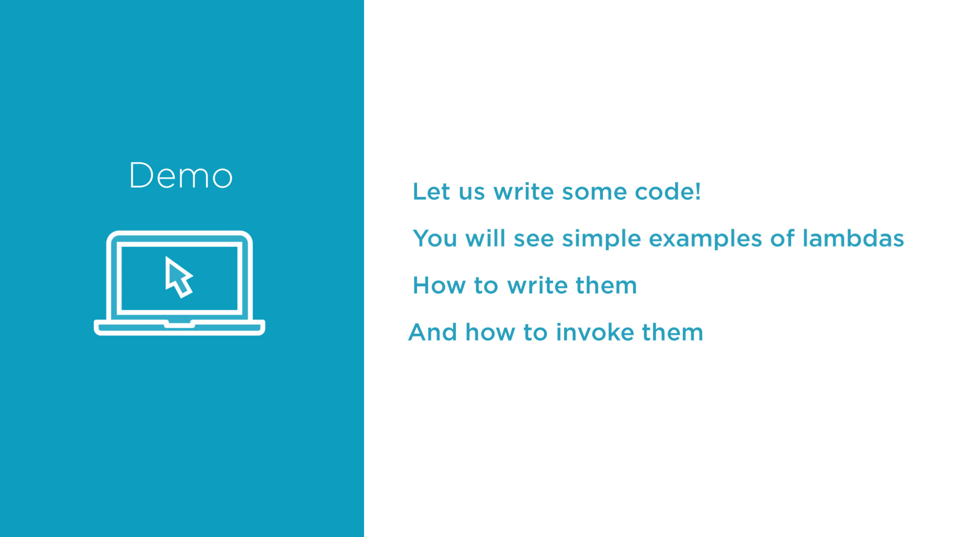

Slide 11
The JDK provide a toolbox of 40+ types.
In java.util.function package
It is organized in 4 categories:
Supplier
Consumer
Predicate
Function
Notes:
We are going to talk about how to write suppliers and consumers, and we just saw first examples of that in the previous modules/set, and also predicates and functions. All of these four functional interfaces are part of a bigger family, that is the java.util.function package.
The JDK gives us a standard functional interface toolbox that is used all over the place, especially in the collection framework and in the Stream API. There are more than 40 interfaces in it. That's really a lot, and those 40 functional interfaces can be put in four different categories. If you check the collection framework and the Stream API, you will see that especially the predicates and the functions are used absolutely everywhere. So, it's really important
to understand these functional interfaces,
how you can implement them,
and how you can use them,
and this is what you're going to see now.

Slide 12
public interface Supplier<T> {
T get();
}
Supplier<String> supplier =
() -> "Hello!";
The Supplier
Does not take any argument
Produces a value

Slide 13
public interface Consumer<T> {
void accept(T t);
}
Consumer<String> consumer = s -> System.out.println(s);
The Consumer
Takes any argument
Does not return anything

Slide 14
public interface Predicate<T> {
boolean test(T t);
}
Predicate<String> isEmpty =
s -> s.isEmpty();
The Predicate
Takes any argument
returns a Boolean
Used to filter data

Slide 15
public interface Function<T, R> {
R apply(T t);
}
Function<User, String> getName =
user -> user.getName();
The Function
Takes any argument
return any type
Used to map data

Slide 16
public interface Runnable {
void run();
}
Runnable alert = () -> System.out.println("I am Groot");
The Runnable
Does not takes any argument
Does not return any type
Notes:
With this runnable interface, you can see a very important point of this functional interface definition. The definition of the functional interface is, in fact, backward compatible.
Has the runnable interface changed in Java 8, where lambda expressions and this notion of functional interfaces has been introduced? The answer is no.
The runnable interface was not touched. But with the definition of the functional interface we have, it suddenly became a functional interface without having to touch it. And this is precisely the reason why this functional interface annotation is not mandatory. If it had been mandatory, this runnable interface wouldn't have become a functional interface starting with Java 8. Since this annotation is optional, you do not need it, and this runnable interface, back from the old days of Java 1, is now a functional interface that can be implemented using lambda expressions.
And this point is very important for you because it is something you can use in your code. If you have parts of your application code that have been written years ago before the days of Java 8, with interfaces that have become functional now ,then you can implement them using lambda expressions without having to recompile them. This is a very powerful point of lambda expressions in Java.

Slide 17
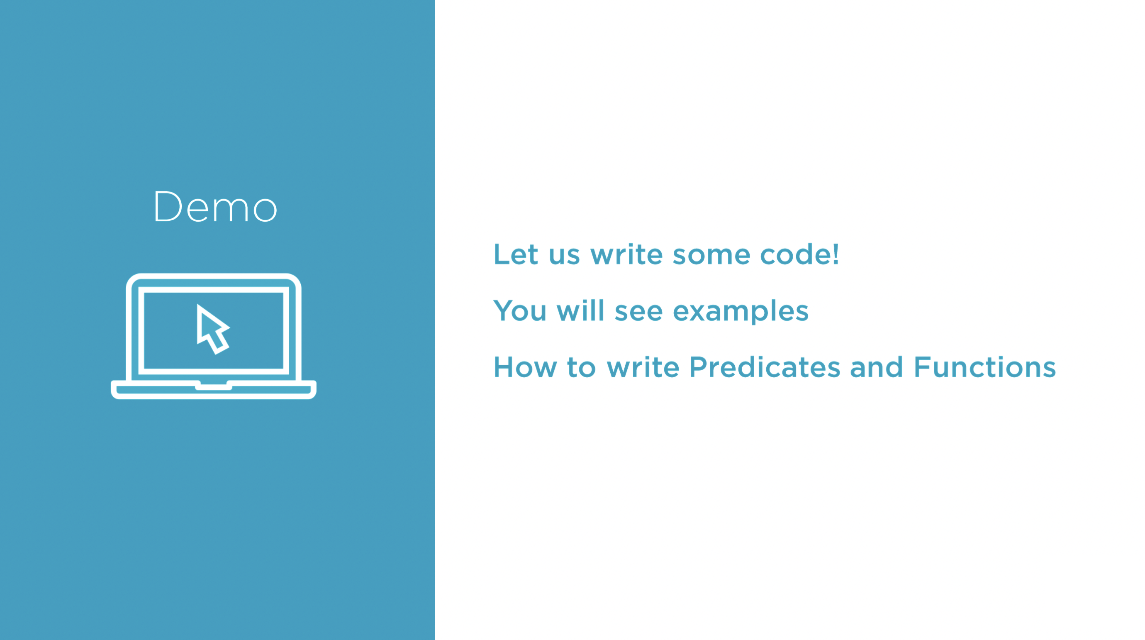

Slide 18
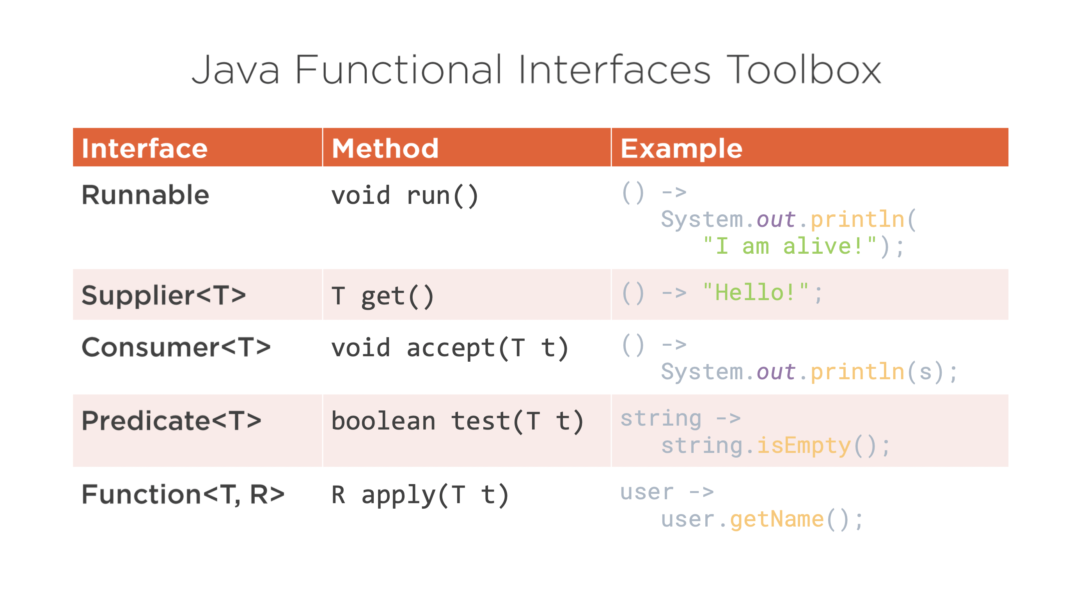

Notes:
Ok, So far we saw the four main categories of functional interfaces from the java.util.function toolbox that you need to know.

Slide 19
Lambdas & Performance
Lambdas are not instances of anonymous classes!
But whatever we write in a lambda can also be written in anonymous class
In a way you could say they are anonymous methods
Between lambda and anonymous class, compiled code is different
Lambda use invokedynamic
Compared to anonymous class, lambda is at least 6X faster.
Notes:
And, let us start with a question. How fast lambda expressions are? I started this course with telling you that lambdas are not the same as instances of anonymous classes, and I'm certainly not going to tell you the contrary now. This is still true, of course, but what you can put in a lambda can be written also in an instance of anonymous classes, right? So you can have an equivalent written in a lambda expression and in an instance of an anonymous class. And this is very useful if you want to make some comparisons. The first thing you may want to compare is what did the compiler generate for you. Lambda expressions are compiled using specific bytecode instructions called invokedynamic introduced in Java 7, almost specific to lambda expressions. So if the compiled code is not the same in both cases, you can expect the performances to be very different, and indeed they are very different. If you compare precisely and measure the differences in performance between lambdas and anonymous classes, you will see at least 6x difference in the execution of your code, and that's really a lot. But in fact, in some cases you can go even faster.

Slide 20
Performance mistakes to avoid with Lambdas
Avoid using boxed types
Consider primitive specialized functional interface instead. E.g.
IntPredicate
LongSupplier
IntFunction<T>
LongToIntFunction
Avoid creating lambdas in loop
Notes:
Now, few things to consider here to get most out of Lambdas.

Slide 21
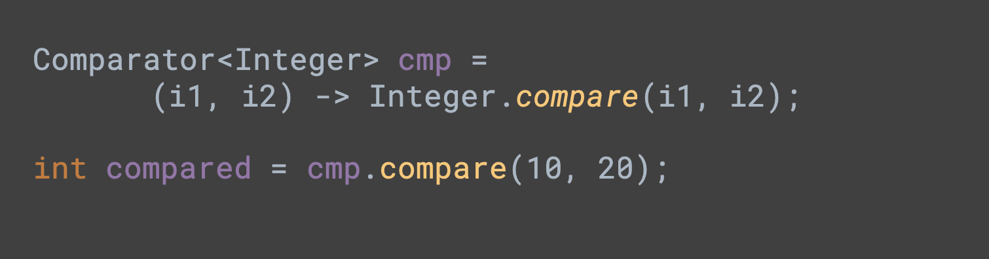
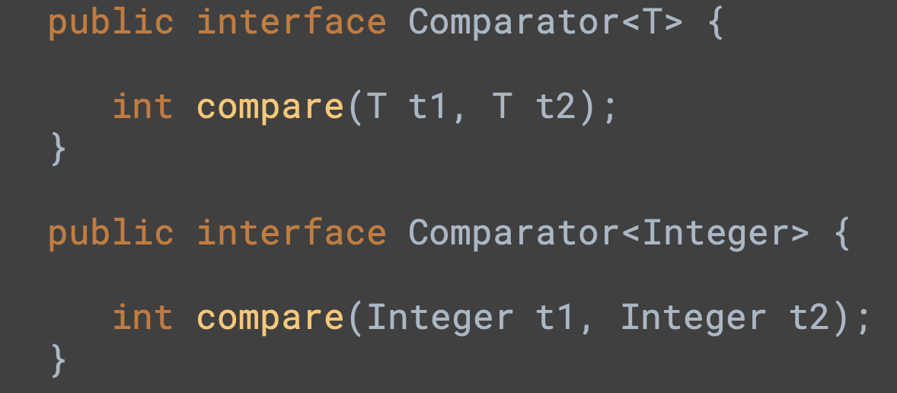

Slide 22

Working with primitive specialized functional interfaces

Slide 23
Chaining and Composing Lambdas
Creating Lambdas with Factory Methods

Slide 24
Method References
Usage scenario: lambda body contains just a method call.
Problem addressed: further minimizes lambda syntax
Notes:
We use lambda expressions to create anonymous methods.
Given that,
Sometimes, however, a lambda expression does nothing but call an existing method.
In those cases, it's often clearer to refer to the existing method by name.
Method references enable you to do this;
they are compact, easy-to-read lambda expressions for methods that already have a name.

Slide 25
Kinds of Method References
Kind | Syntax | Examples
Reference to a static method | ContainingClass::staticMethodName | String::join Integer::parseInt
Reference to an instance method of a particular object | containingObject::instanceMethodName | String s = “Hello”; s::isEmpty s::concat
Reference to an instance method of an arbitrary object of a particular type | ContainingType::methodName | String::compareToIgnoreCase String::concat
Reference to a constructor | ClassName::new | HashSet::new

Slide 26
Method References

Slide 27
Q&A
for further queries reachable at
ksingh33@bofa.com

